Slide 1
Current primary ICD prevention: Is it adequate in South Korea?
Dong-Hyeok Kim
Department of Cardiology, College of Medicine
Ewha Womans University Medical Center, Seoul, Korea

Slide 2
Korean Heart Rhythm Society COI Disclosure
Dong-Hyeok Kim, MD.
The authors have no financial conflicts of interest
to disclose concerning the presentation

Slide 3
ICD Hot Issues
Primary vs. Secondary prevention
Ischemic primary vs. Non-ischemic primary prevention
Primary non-ischemic DCMP vs. other CMP (etc., HCMP)
Primary or secondary prevention on Variant angina
Current primary ICD prevention:
Is it adequate in South Korea? → Not Yet

Slide 4
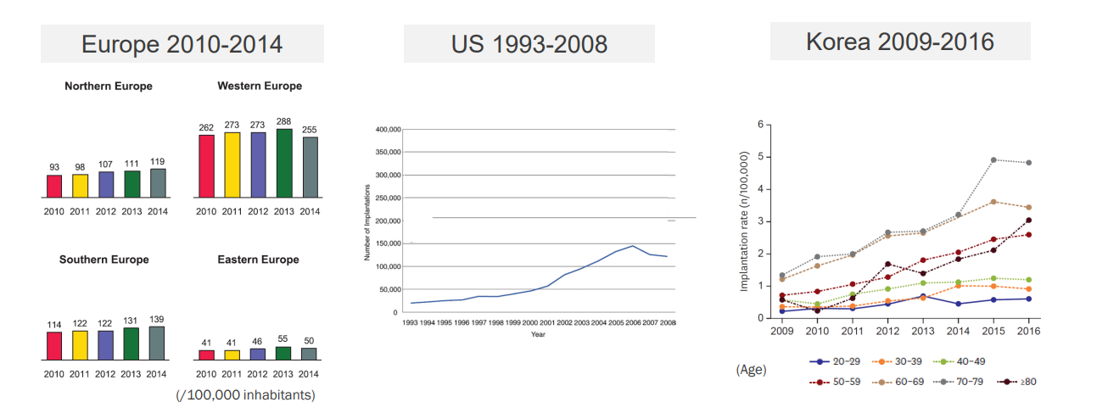
Trend of ICD Implantation
Raatikainen MJ et al. Europace. 2015 Jan;17 Suppl 1:i1-75.
Greenspon AJ et al. J Am Coll Cardiol. 2011 Aug 30;58(10):1001-6.
Lee JH et al. Korean Circ J. 2019 Sep;49(9):841-852.

Slide 5
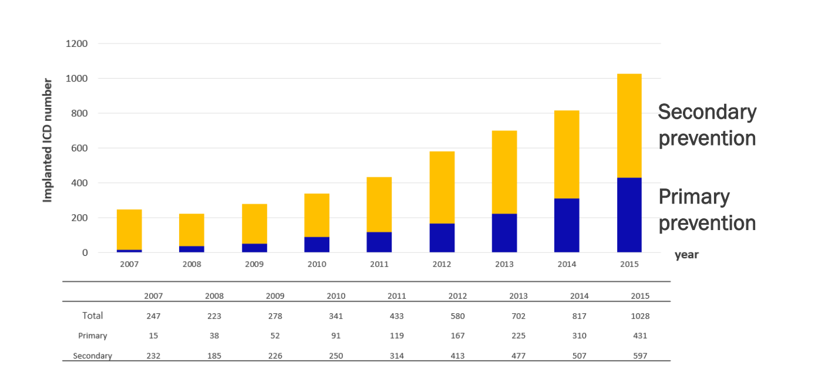
Annual number of New ICD implantation in Korea
Pacing Clin Electrophysiol. 2019;42:1086–1094.

Slide 6
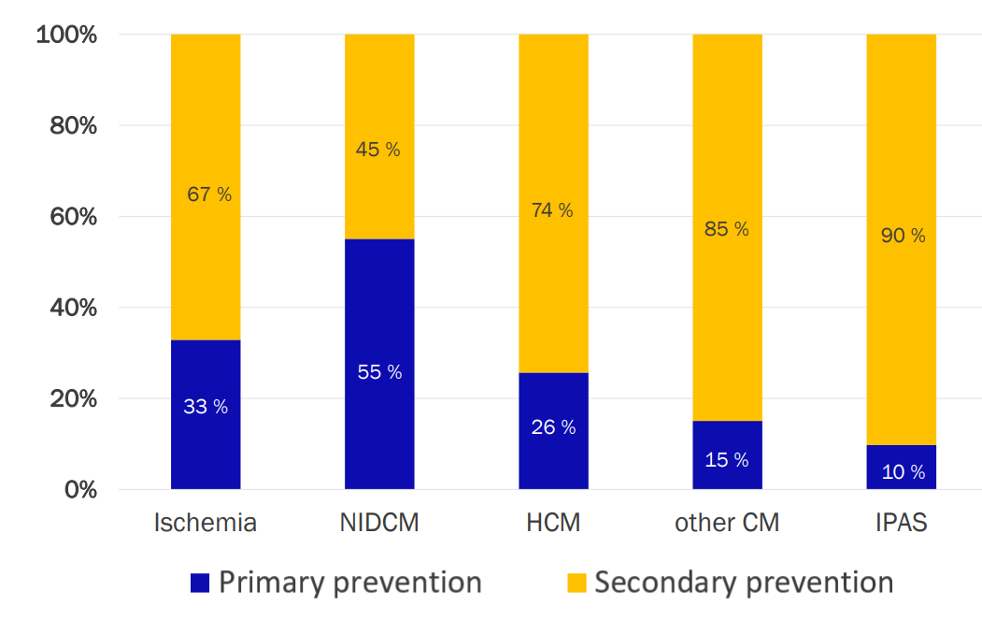
ICD Indication proportion as Etiology in Korea
Pacing Clin Electrophysiol. 2019;42:1086–1094.

Slide 7
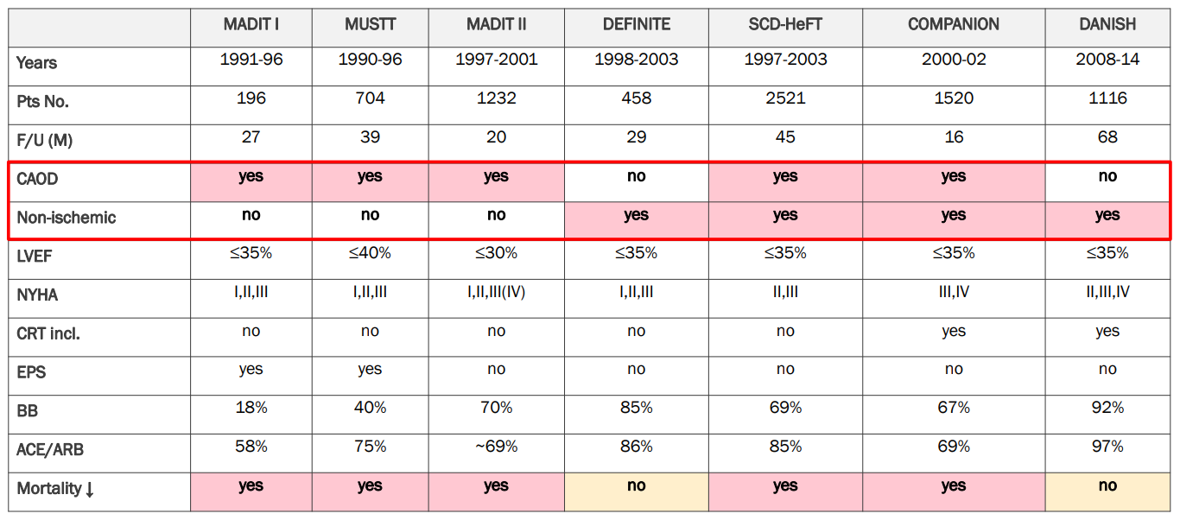
Clinical Trial Evidence of ICD primary prevention
All cause death : HR 0.65, p=0.08
SCD : HR 0.20, p=0.006
All cause death : HR 0.87, p=0.28
SCD : HR 0.50, p=0.005

Slide 8
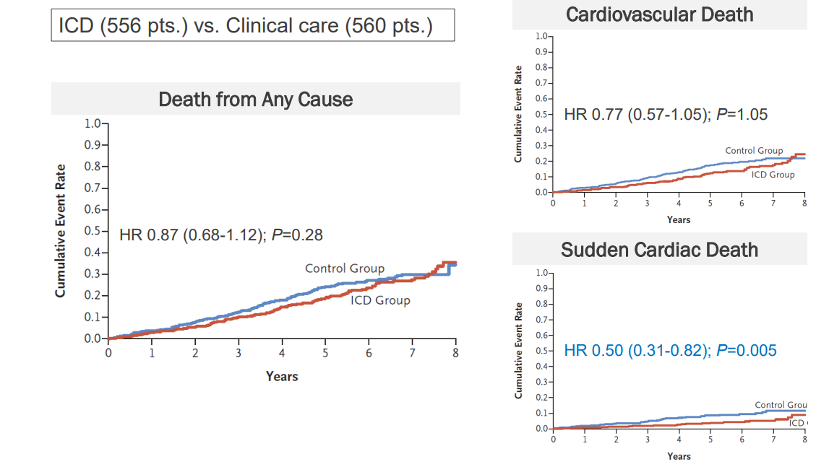
DANISH
Danish Study to Assess the Efficacy of ICDs in Patients
with Non-Ischemic Systolic Heart Failure on Mortality
N Engl J Med. 2016 Sep 29;375(13):1221-30.

Slide 9
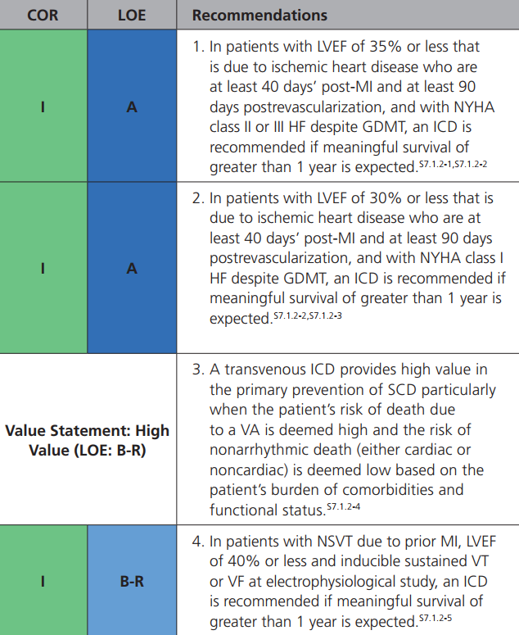
ICMP, primary prevention
Korea
Global standard
USA
NYHA class I
Korea
No symptom criteria
Korea
Global standard
Circulation. 2018;138:e272–e391.

Slide 10
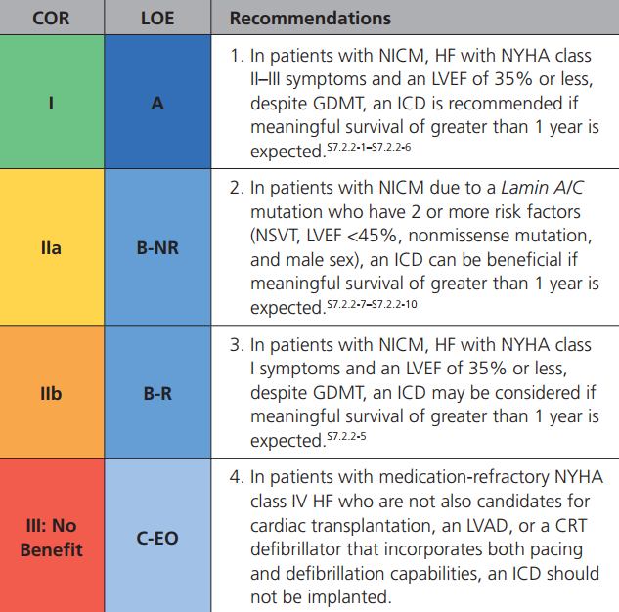
Non-ICMP, primary prevention
Korea
Global standard
K
No criteria
No Korean reimbursement
USA
Genetic considerations
Circulation. 2018;138:e272–e391.

Slide 11
ICD primary Prevention Korean insurance
ICMP
심근경색 발생 후 40일 경과한 허혈성 심부전으로 적절한 약물치료에도 불구하고 아래에 해당하며 1년 이상 생존이 예상되는 경우
(가) 심구혈률(EF) ≤ 30%
(나) 심구혈률(EF) 31~35%로 NYHA class Ⅱ, Ⅲ의 증상을 보이는 경우
(다) 심구혈률(EF) ≤ 40% 환자로 비지속성 심실빈맥(NSVT)이 있으며 임상전기생리학적검사(EPS)에서 혈역동학적으로 의미있는 심실세동(VF)이나 지속성 심실빈맥(VT)이 유발되는 경우
(2) NICMP, DCMP
비허혈성 심부전으로 3개월 이상의 적절한 약물치료에도 불구하고 NYHA class II, III의 증상을 보이는 심구혈률(EF) ≤ 35%인 환자에서 1년 이상 생존이 예상되는 경우
* 적절한 약물치료 - 3개월 이상
(ACE inhibitor/Angiotensin Receptor Blocker + Diuretics ± Beta-blocker), ARNI ???

Slide 12
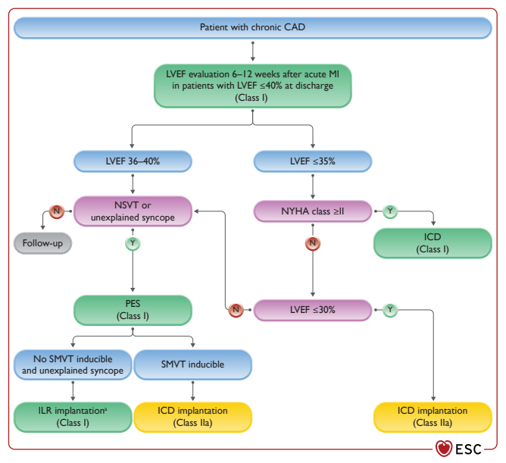
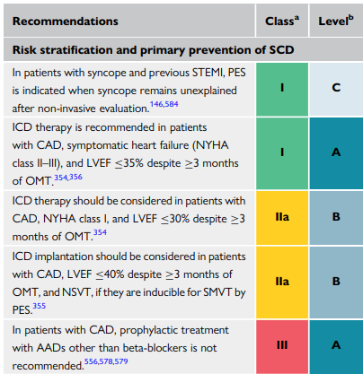
Recommendations for risk stratification, sudden cardiac death prevention, and treatment of ventricular arrhythmias in chronic coronary artery disease (CAD, ICMP)
2022 ESC guideline in Ventricular arrhythmia and SCD

Slide 13
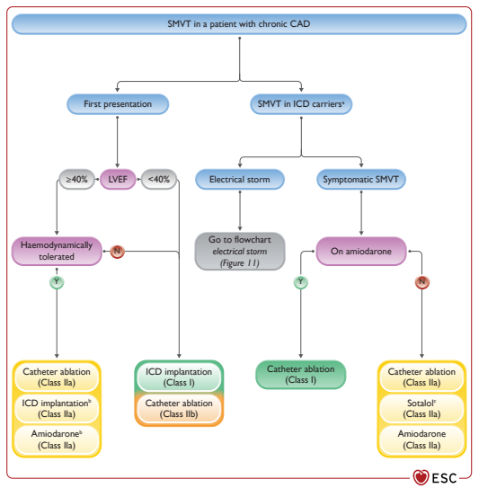
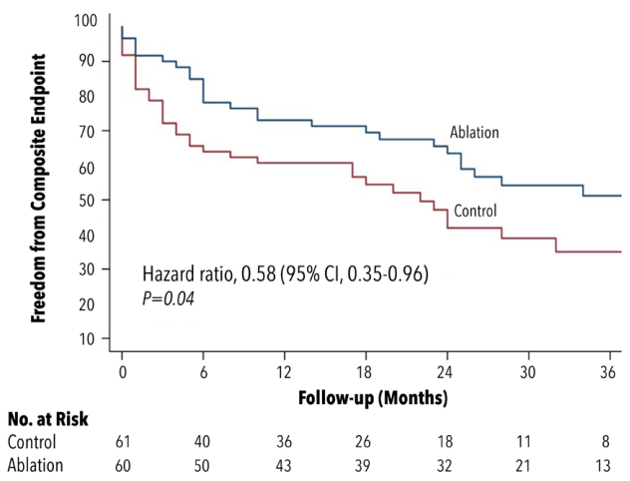
Sustained mono-morphic VT (SMVT) in chronic CAD, ICMP
ventricular tachycardia
recurrence, cardiovascular hospitalization,
or death.
Catheter ablation
±
ICD implantation
2022 ESC guideline in Ventricular arrhythmia and SCD
PAUSE-SCD Randomized Trial, Circulation. 2022;145:1839–1849.

Slide 14
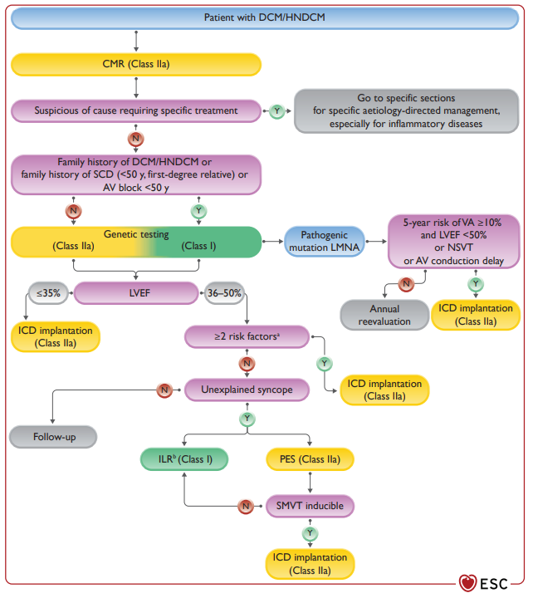
DCM and Hypokinetic non-DCM
심부전 한국 보험 기준
2) 비허혈성 심부전으로 3개월 이상의 적절한 약물치료에도 불구하고 NYHA class II, III의 증상을 보이는 심구혈률(EF) ≤ 35%인 환자에서 1년 이상 생존이 예상되는 경우
2022 ESC guideline in Ventricular arrhythmia and SCD

Slide 15
HCM, secondary and primary prevention
Circulation. 2018;138:e272–e391.

Slide 16
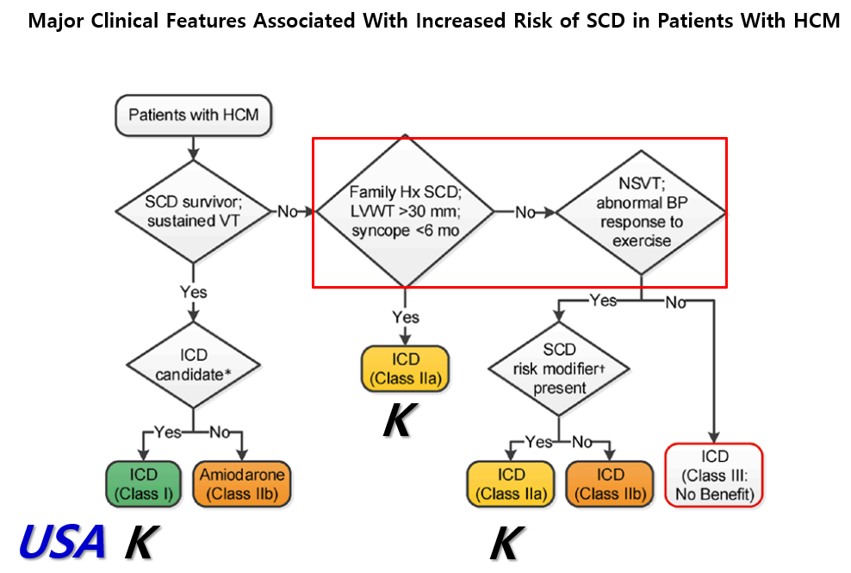
HCM, secondary and primary prevention
Circulation. 2018;138:e272–e391.

Slide 17
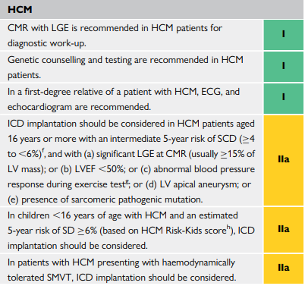
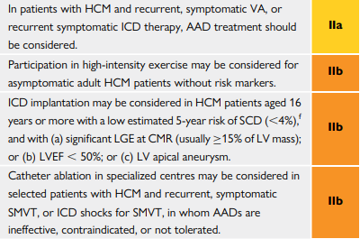
HCMP
비후성 심근병증, 한국 보험 기준
1) 아래의 급성 심장사(Sudden Cardiac Death)의 위험인자가 1개 이상인 경우
- 아 래 -
가) 좌심실 벽두께 30 mm 이상(단, 16세 미만 환자는 Z-score≥6을 포함)
나) 비후성심근병증에 의한 급사의 가족력
다) 6개월 내에 한 번 이상의 원인미상의 실신
2) 아래의 급성 심장사(Sudden Cardiac Death)의 부가적 위험인자 중 1개 이상을 동반한 비지속성 심실빈맥(Non-sustained Ventricular Tachycardia, NSVT) 또는 비정상적인 운동혈압반응(abnormal blood pressure response with exercise)이 있는 경우
- 아 래 -
가) 30세 미만
나) 자기공명영상에서 지연조영증강
다) 좌심실유출로 폐색
라) 과거의 실신
마) 좌심실류
바) 좌심실구혈율 50%미만
2022 ESC guideline in Ventricular arrhythmia and SCD

Slide 18
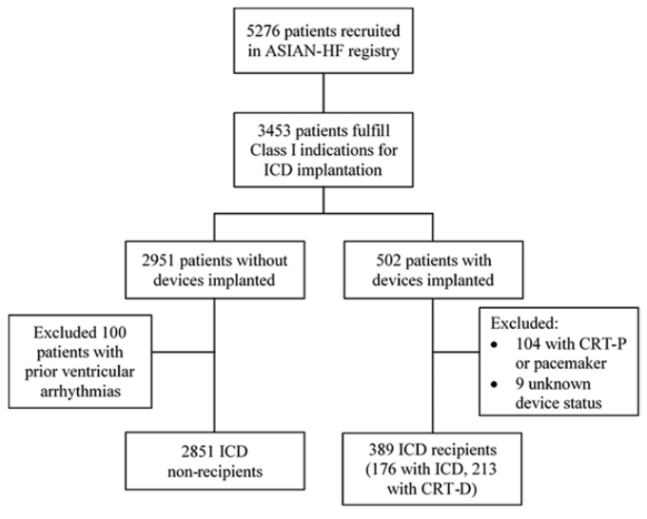
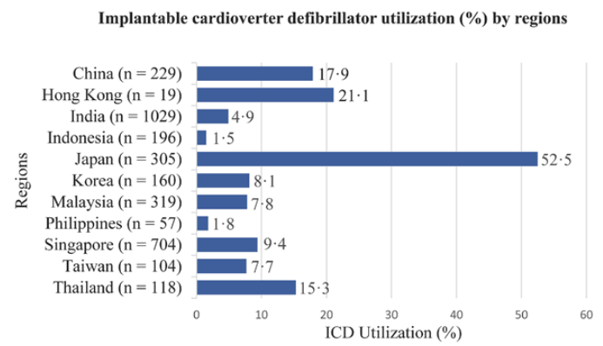
ASIAN-HF registry
ICDs reduce mortality risk. However, ASIAN HF registry data showed that utilization of ICD in Asia is low.
Circ Cardiovasc Qual Outcomes. 2017 Nov;10(11).

Slide 19
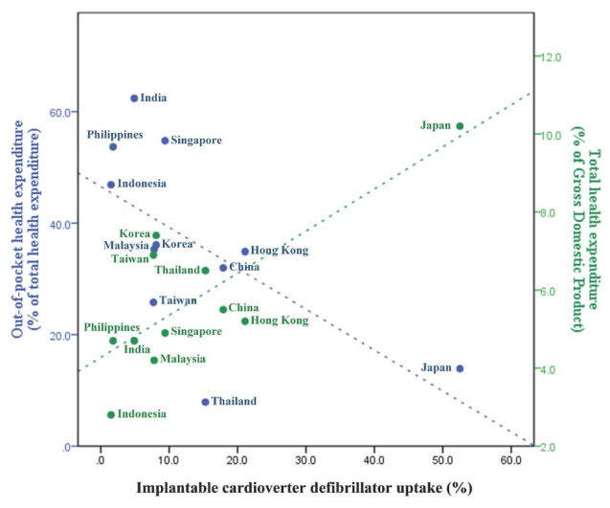
ASIAN-HF registry
Education
Personal pay
Nation support
Reimbursement
Circ Cardiovasc Qual Outcomes. 2017 Nov;10(11).

Slide 20
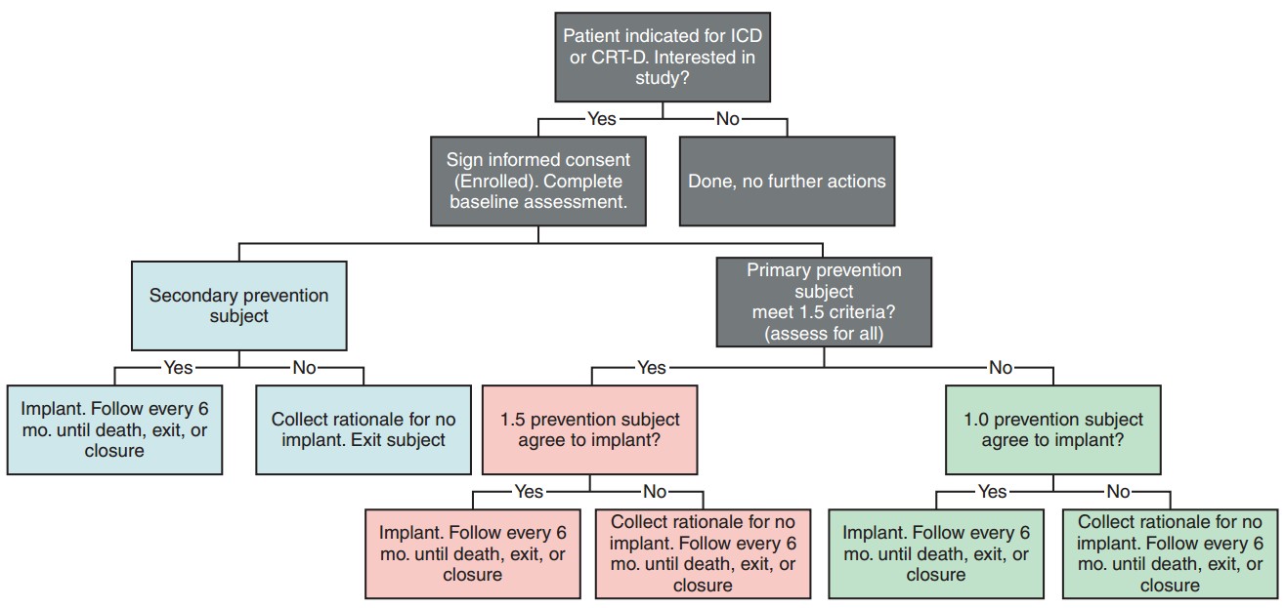
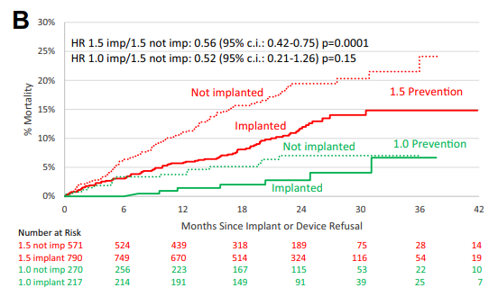
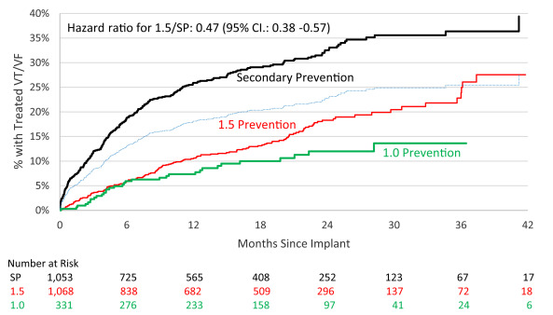
Improve SCA Study
Broaden the primary prevention
1. The Improve SCA study will investigate a subset of primary prevention (PP) patients, believed to be at similar risk of life-threatening ventricular arrhythmias as secondary prevention (SP) patients.
2. Primary prevention patients will be assessed for additional risk factors: syncope/pre-syncope, non-sustained ventricular tachycardia, frequent premature ventricular contractions, and low left ventricular ejection fraction. Those PP patients with one or more risk factors will be categorized as ‘1.5’ prevention group.
Europace 2015 Nov; 17(11): 1720–1726.
Heart Rhythm. 2020 Mar;17(3):468-475.

Slide 21
How about Korea ?
In Korea, patients have a phobia for device just like other Asian patients.
So the number of implantation of device is so low in Korea.

Slide 22
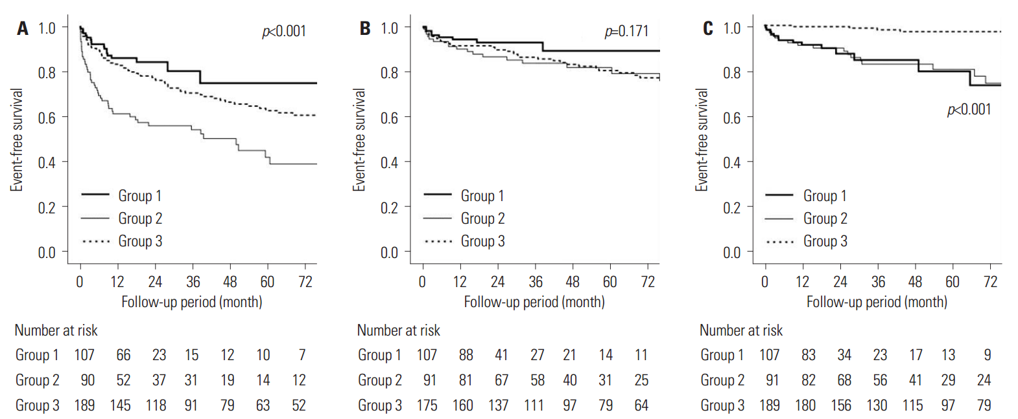
Primary and secondary prevention ICD in Korea
appropriate shock
In-appropriate shock
mortality
Mean follow up period : 147±8 months
VT or VF events (primary vs. secondary)
10% vs. 21.5% (p=0.533)
A. Early phase within 40 months
B. Late phase after 40 months
Appropriate (A) and inappropriate (B) implantable cardioverter-defibrillator (ICD) therapy, and all-cause mortality (C)
group 1 : primary prevention for HF with ICD or CRT-D
group 2 : secondary prevention for HF with ICD or CRT-D
group 3 : primary and secondary prevention for non-HF with ICD
Yonsei Med J 2017 May;58(3):514-520.

Slide 23
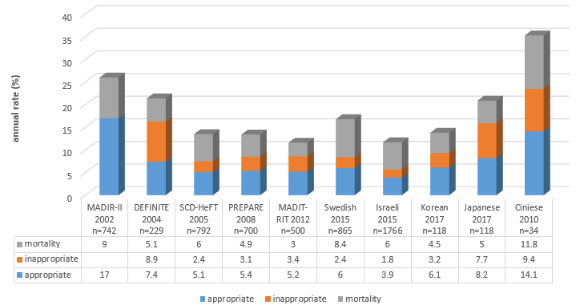
Primary and secondary prevention ICD in Korea
This small study with only about 100 patients in Korea also showed that efficacy of ICD for primary prevention is not low.
Yonsei Med J 2017 May;58(3):514-520.

Slide 24
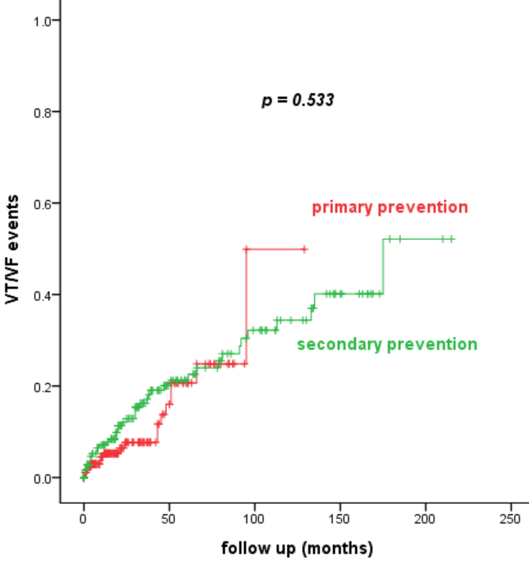
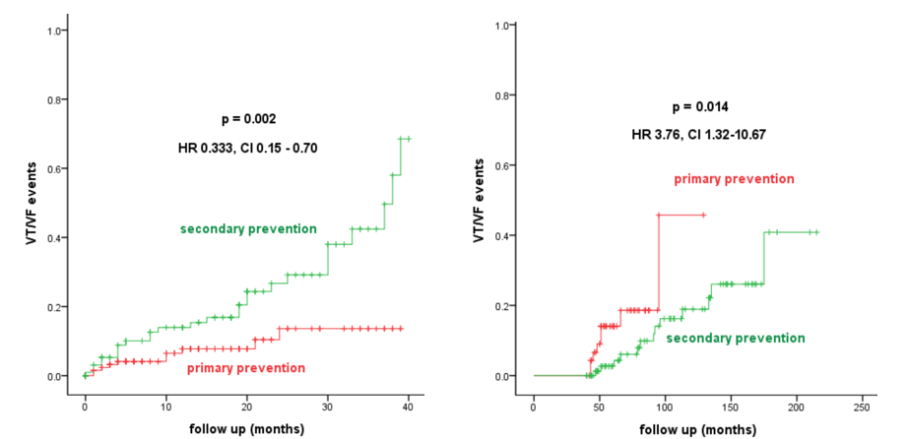
Primary and secondary prevention ICD Sejong General Hospital, Korea
Mean follow up period : 147±8 months
VT or VF events (primary vs. secondary)
10% vs. 21.5% (p=0.533)
A. Early phase within 40 months
B. Late phase after 40 months
Interesting point is that overall primary and secondary prevention is not different. However, after long-term follow up after 40 months, VF/VT event and needed appropriate ATP and shock is higher in primary group. This result supports and emphasizes the importance of primary ICD therapy in long-term outcomes.
APHRS 2017

Slide 25
Responder and LVEF in CRT Sejong General Hospital, Korea
LVEF 33.64%
LVEF 25.84 %
Pre LVEF
Post LVEF
85 cases, 2005~2017, CRT clinic in Sejong General Hospital, mean 363 days follow up
Unpublished data from Sejong General Hospital

Slide 26
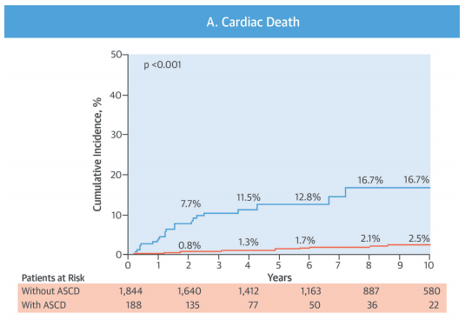
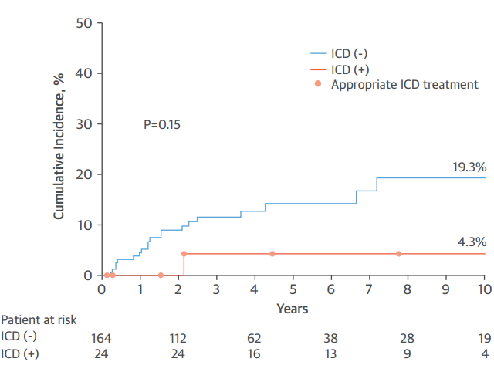
Prognosis of Variant Angina Manifesting as Aborted Sudden Cardiac Death
J Am Coll Cardiol 2016;68:137–45.

Slide 27
Summary
Primary vs. Secondary prevention
: not-inferior of primary
Ischemic primary vs. Non-ischemic primary prevention
: questionable non-ischemic
Primary non-ischemic DCMP vs. other CMP (etc., HCMP)
: under-utilization, in Asia
Primary or secondary prevention on Variant angina
: ICD need for post variant angina and ROSC
Well established AF guideline in Korea
: However, VA and CIED guideline in Korea ? Reimbursement system ?
2022
2018
2018

Slide 28
Thank You for your attentions

